Slide 1

Team Name : CommitOfOne
Team Leader Name : Anshul Wycliffe
Problem Statement : AI for Communities, Access & Public Impact

Slide 2

Brief about the Idea:
CivicBio – Smart Biomedical Waste Governance SystemCivicBio is a QR-enabled, role-based biomedical waste management platform designed for civic bodies to ensure:End-to-end waste traceabilityRegulatory complianceReal-time monitoringAI-powered anomaly detection
# Problem
Biomedical waste is:
              Manually tracked
            Poorly audited
            Vulnerable to misreporting
            Hard to monitor at city scale
            # Our Idea
            Digitize the entire lifecycle:
            Facility → QR Generation → Collection → Disposal → Civic Audit
            # With:
            AWS-powered anomaly detection
            Real-time dashboards
            Cloud-based logging & monitoring

Slide 3
🔥 1. Governance-First Design
Most systems focus only on:
Logistics
Tracking
CivicBio focuses on:
Accountability
Civic approval control
AI-based anomaly detection
Audit logging via AWS CloudWatch
🔥 2. AI-Based Statistical Anomaly Detection
  Instead of just tracking waste,
  we detect:
  Sudden spikes in waste
  Unusual patterns
  Suspicious reporting
Using:
Z-score Statistical Detection
(Mean & Standard Deviation)
Powered by:
AWS Lambda
Serverless architecture

Slide 4
🔥 3. Serverless & Scalable
Unlike traditional systems:
No heavy servers
No complex ML pipelines
We use:
AWS Lambda
CloudWatch
MongoDB
Scales automatically.

Slide 5
List of features offered by the solution
.
Facility
Waste generation
QR code tagging
Compliance status
Collector
Facility verification via QR
Waste batch scanning
Issue reporting
Disposal
Waste verification
Treatment method logging
Disposal confirmation
Civic Authority
Approval workflow
Real-time KPIs
Anomaly detection alerts
High-risk facility detection
AI Layer
30-day historical analysis
Z-score anomaly detection
High-risk scoring
Cloud logging

Slide 6
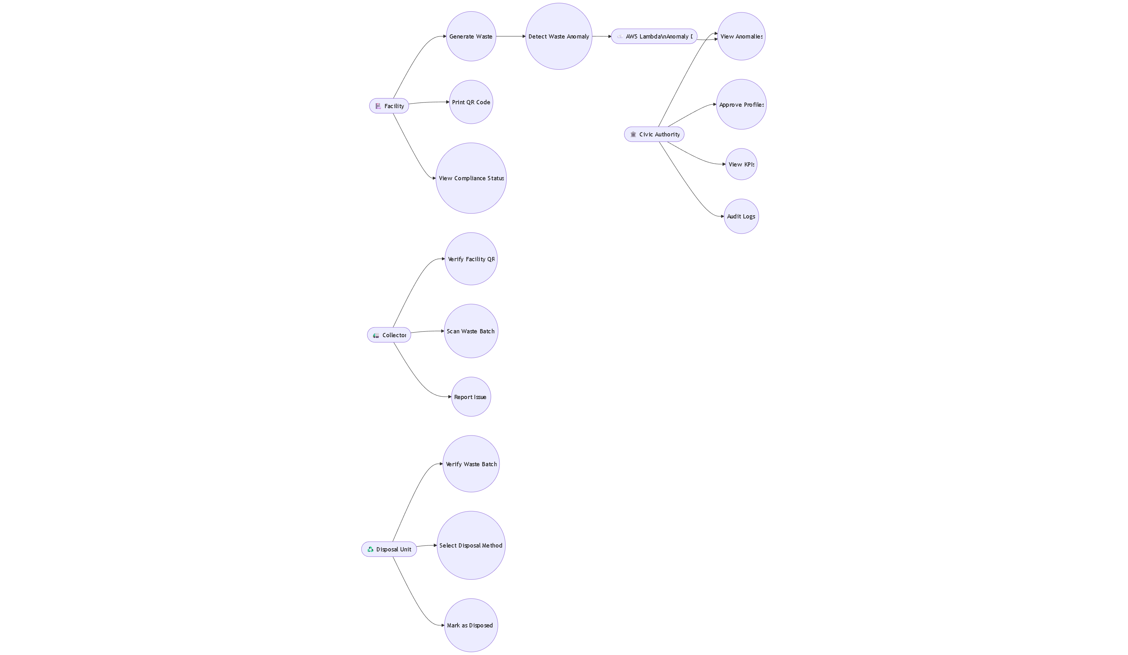
Process flow diagram or Use-case diagram

Slide 7
Process flow diagram or Use-case diagram

Slide 8
Process flow diagram or Use-case diagram

Slide 9
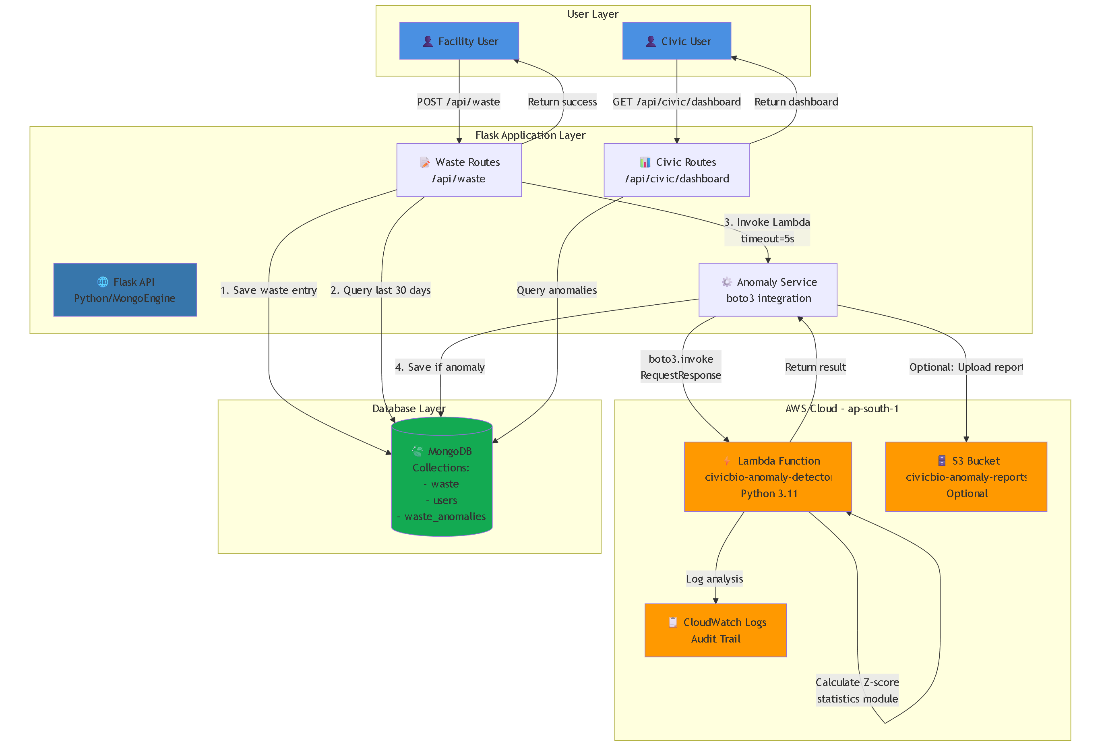
Architecture diagram of the proposed solution:

Slide 10
Technologies to be used in the solution:
Backend
Python
Flask
MongoEngine (MongoDB)
AWS Cloud
AWS Lambda (Anomaly Detection)
CloudWatch (Audit Logging)
S3 (Optional Report Storage)
Frontend
HTML
CSS
JavaScript
Bootstrap
AI Technique
Z-score based anomaly detection
Statistical modeling using Python standard library

Slide 11


